Slide 1
Epidemiology of tuberculosis, France
2022 data
Santé publique France – infectious diseases DIVISION
Update: December 2023

Slide 2
National tuberculosis Surveillance in France: data sources
Mandatory notification (Santé publique France)
Tuberculosis disease since 1964
Latent tuberculosis infection (children < 15 years old *) since 2003
Treatment outcome surveillance on tuberculosis disease since 2007
Laboratory data (National reference laboratory for mycobacteria and anti-tuberculosis drug resistance)
MDR case reports
Anti-TB drug resistance (hospital laboratory network)
Mortality data (INSERM, CépiDc) : death certificates
* < 18 years old since 2021

Slide 3
Case definitions for tuberculosis surveillance in france
Tuberculosis disease
Confirmed. Disease confirmed by culture (Mycobacterium tuberculosis complex) or by a DNA + for M.tuberculosis in an AFB positive sample
Or
Probable. Clinical and/or radiological signs compatible with tuberculosis and clinician’s decision to treat with a full anti-TB treatment
Tuberculosis infection (in persons aged < 18 years old)
Positive 5TU tuberculin skin test without clinical or paraclinical signs (induration > 15mm if BCG, or > 10 mm without BCG, or increase of at least 10 mm compared to previous TST < 2 years)
Mycobacteria from tuberculosis complex
M. tuberculosis, M. bovis , M. africanum, M. microtti, M. canetti, M. pinnipedii, M. caprae

Slide 4
Tuberculosis morbidity, France, 1972-2022

Slide 5
NUMBER OF Tuberculosis cases and notification rate by clinical form, France, 2000-2022

Slide 6
Number of Tuberculosis cases and notification rate by region of residence, France, 2022

Slide 7
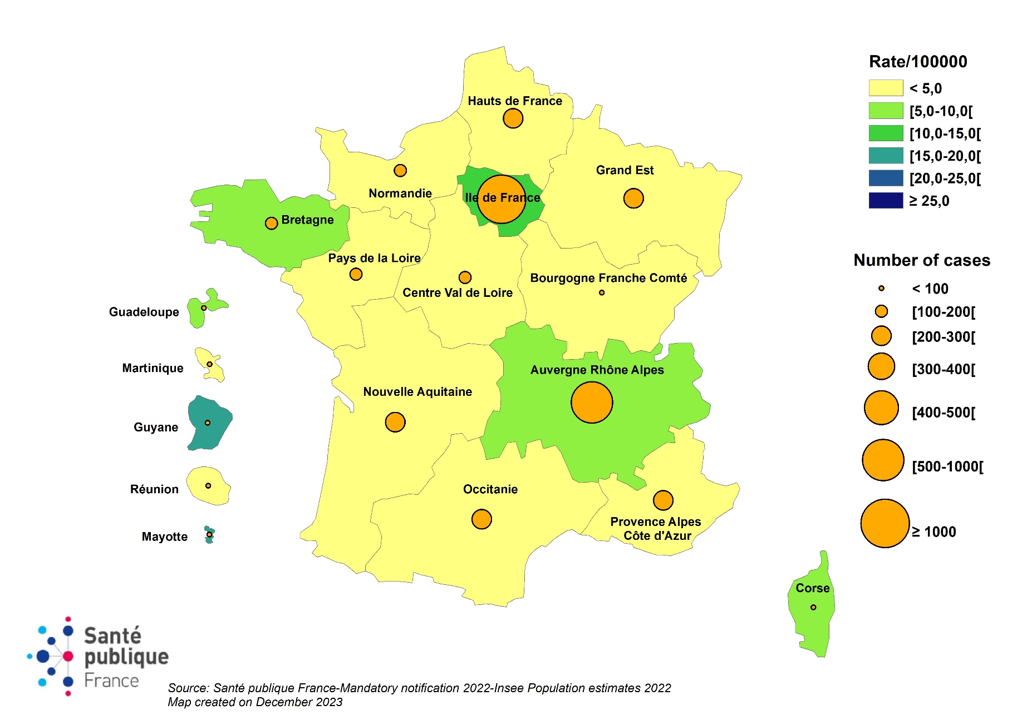
Tuberculosis cases and notification rate by region of residence, France, 2022

Slide 8
Tuberculosis cases notified by site of disease, France, 2022
Total des cas déclarés
4217
TB
pulmonaire
*
TB exclusivement extra
Localisation non
renseignée
3004 (71%)
pulmonaire
1165 (28%)
48 (1%)
::
TB pulmonaire *
Avec localisation pleurale
microscopie + **: 1364
ou ganglionnaire intra
thoracique : 507
TB pulmonaire *
TB exclusivement extra
microscopie
-
ou inconnue
pulmonaire
autre
:
658
et culture +
** :752
TB
pulmonaire
*
autres
:
95 cas de
méningite
TB
associée
ou non à d’autres localisations
888
* with or without extra pulmonary localisation
** respiratory specimen
Source: Santé publique France, mandatory notification

Slide 9
Type of residence of notified TB cases, France, 2022
Type of residence | N | %
Congregate settings | 694 | 19,3% *
Sheltered housing | 417 | 11,5%
Nursing home for eldery | 26 | 0,7%
Prison | 31 | 0,8%
Other | 182 | 5,0%
No information available | 33 | 0,9%
Homeless persons
Number of cases | 190
Percentage | 6,2% **
Rate (/100 000) | 63
* Among cases with known information (694/ 3601); ** Among cases with known information (190/ 3059)
Source: Santé publique France, mandatory notification, Population data for the homeless: Fondation Abbé Pierre/Insee

Slide 10
Tuberculosis cases notified by sex, age group and birthplace, France, 2022
Sex ratio
68% male [2878 male and 1338 female]
Age (years)
Median | 41 y.o.
<5 | 2.0%
5 - 14 | 2.3%
15 - 24 | 17.8%
25 - 44 | 40.4%
45 - 64 | 21,4%
65 + | 16.1%
Place of birth*
France (n=1056) | 28 %
Foreign-born (n=2663) | 72 %
* 505 cases (12%) cases with no available information on country of birth
Source: Santé publique France, Mandatory ,otification

Slide 11
Tuberculosis notification rate by age group and sex,
France, 2022

Slide 12
Number of Tuberculosis cases notified by place of birth and sex, France, 2022
* Europe : excluding France, including Central and Eastern Europe
Source: Santé publique France, mandatory notification

Slide 13
Tuberculosis notification rate by place of birth,
France, 2022

Slide 14
Tuberculosis notification rate by age group and place of birth, France, 2022

Slide 15
Context of diagnosis by age group, tuberculosis cases notified, France, 2022

